Slide 1
Heavy flavour tagging
CMS POS 2017

Slide 2
Why?
QCD:
“All jets are created equal…”

Slide 3
Why?
QCD:
“All jets are created equal…”
EWK:
“…but some jets are more equal than others.”

Slide 4
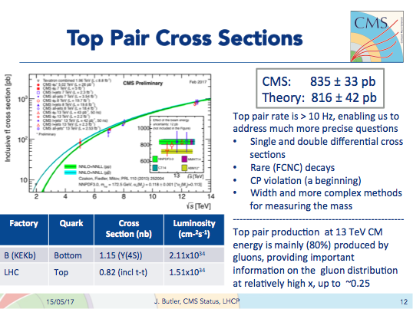
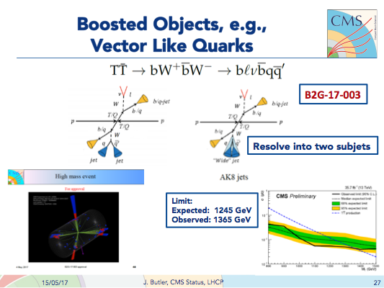
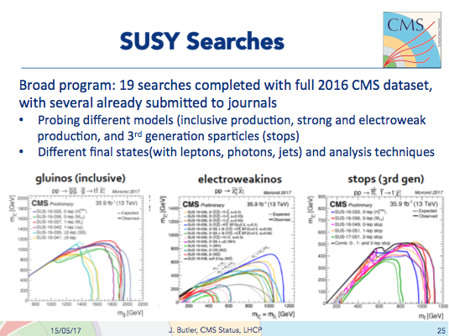
Why? - from our spokesman LHCP highlights
… and many more

Slide 5
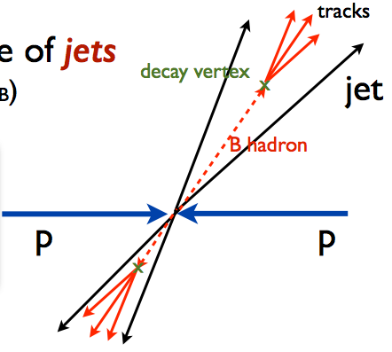
How?
At LHC energies b-quarks hadronise and produce jets containing B-hadrons (B⁺, B⁻, B⁰, Bs, LB)
Their lifetime (~1.5ps) and Lorentz boost lead to displaced decay vertices
Look for displaced tracks and secondary vertices within the jet

Slide 6

How? - Impact Parameter
Measured tracks
Defined as the distance between as the track and the Primary Vertex at their point of closest approach
B decay vertex
x
In the relativistic limit IP is ~ Lorentz invariant.
Decay length is not
Impact
Parameter
Decay Length
Primary
Vertex (PV)

Slide 7
How? - Impact Parameter
The scalar product of the IP segment and the jet direction determines the sign
In a perfect world:
the IP distribution of light-flavour jets would be perfectly symmetric around 0 (and perfectly gaussian, because of various effects entering)
the distribution of b-jets would be mostly positive
In reality: light jets are slightly asymmetric and b-jets have negative IPs as well
X
Jet direction
Positive IP
Negative IP

Slide 8
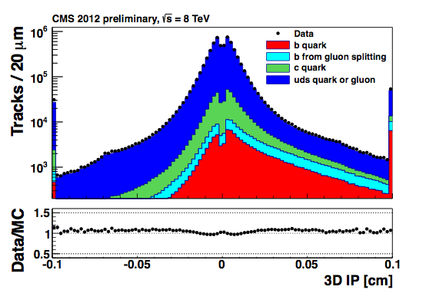
How? - Impact Parameter
The scalar product of the IP segment and the jet direction determines the sign
In a perfect world:
the IP distribution of light-flavour jets would be perfectly symmetric around 0 (and perfectly gaussian, because of various effects entering)
the distribution of b-jets would be mostly positive
In reality: light jets are slightly asymmetric and b-jets have negative IPs as well
X
Jet direction
Positive IP
Negative IP

Slide 9
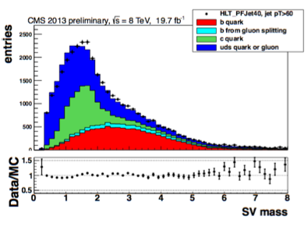
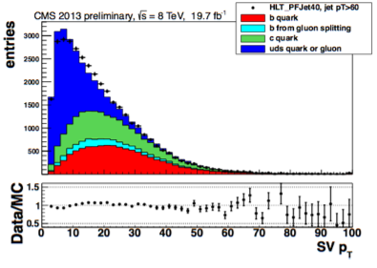
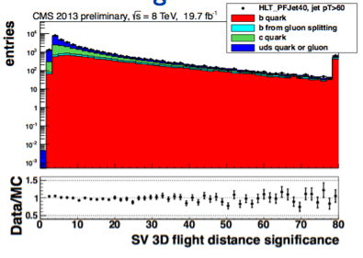
How? - Secondary Vertices
… and many more

Slide 10
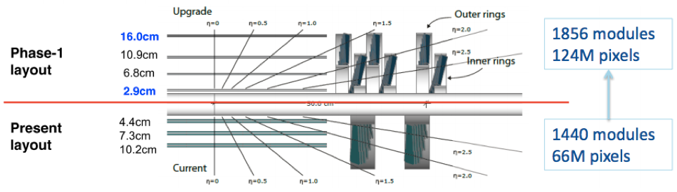
How? - Tracker is very important to us!
Move from 3- to 4-hit coverage to increase redundancy and track finding efficiency
Sensor technology, pixel size and module concept very similar to fit into existing infrastructure
Move from analog to digital readout chip (ROC)
reduced buffer overflow and inefficiency
Barrel: 1184 modules, 48M ➾ 79M pixels
Forward: 672 modules, 18M ➾ 45M pixels

Slide 11
The b-tagging workflow
tracks
jet
PV

Slide 12
The b-tagging workflow
tracks
jet
PV
Track selection

Slide 13
The b-tagging workflow
Track-based
tagger
tracks
jet
PV
Track selection
e.g.: Jet Probability (JP)

Slide 14
The b-tagging workflow
Track-based
tagger
tracks
jet
Secondary vertex (SV)
based tagger
PV
Track selection
SV
Adaptive Vertex Reconstruction (AVR): applied on tracks associated to the jet
Inclusive Vertex Fitter (IVF): on the full set of tracks recorded in the event (SV DR-matched to jet). Current reconstruction default

Slide 15
The b-tagging workflow
Track-based
tagger
tracks
jet
Secondary vertex (SV)
based tagger
PV
Track selection
SV
e/µ
Soft-lepton (SL)
based tagger

Slide 16
The b-tagging workflow
super
combined
combined
Track-based
tagger
tracks
jet
Secondary vertex (SV)
based tagger
PV
Track selection
SV
combined: Combined Secondary Vertex (CSV) DeepCSV DeepFlavour
super-combined: Combined MVA (cMVA) charm-Tagger
e/µ
Soft-lepton (SL)
based tagger

Slide 17
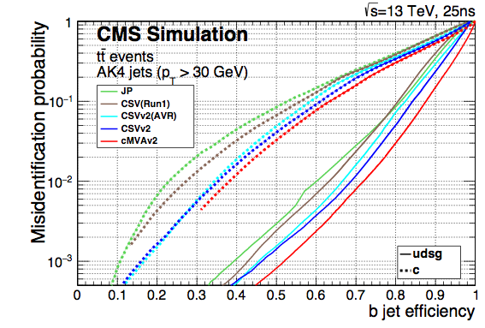
The b-tagging workflow
super
combined
combined
Track-based
tagger
tracks
jet
Secondary vertex (SV)
based tagger
PV
Track selection
Phase 0
SV
e/µ
Soft-lepton (SL)
based tagger

Slide 18
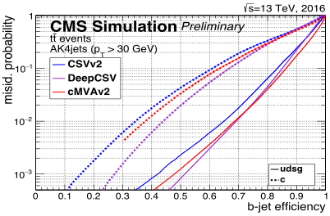
The b-tagging workflow
super
combined
combined
Track-based
tagger
tracks
jet
Secondary vertex (SV)
based tagger
PV
Track selection
Phase I
SV
e/µ
Soft-lepton (SL)
based tagger

Slide 19
The b-tagging workflow
super
combined
combined
Track-based
tagger
tracks
ROC Curves, show performance of the tagger at different purity
jet
Secondary vertex (SV)
based tagger
PV
Track selection
SV
b- vs. c- jet separation is a harder task than b- vs. light
e/µ
Soft-lepton (SL)
based tagger

Slide 20
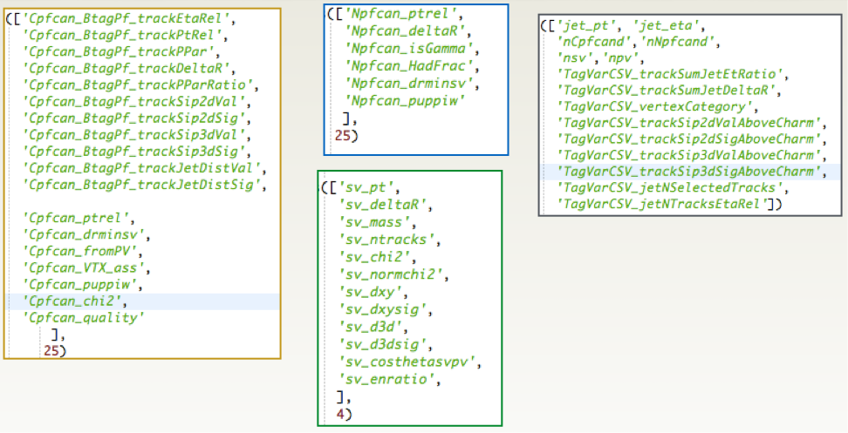
How? - How many input variables?
Potentially, a LOT!

Slide 21
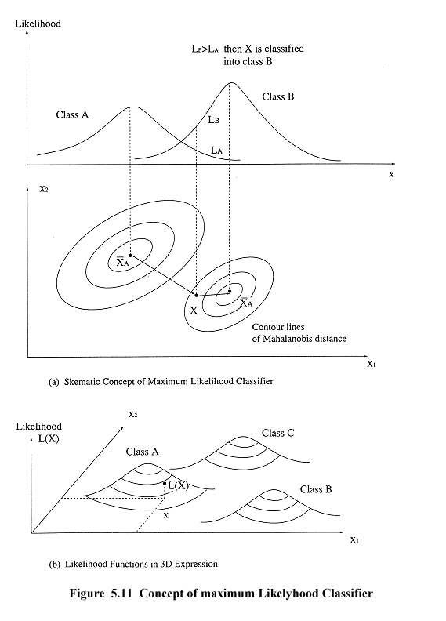
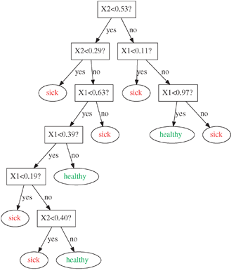
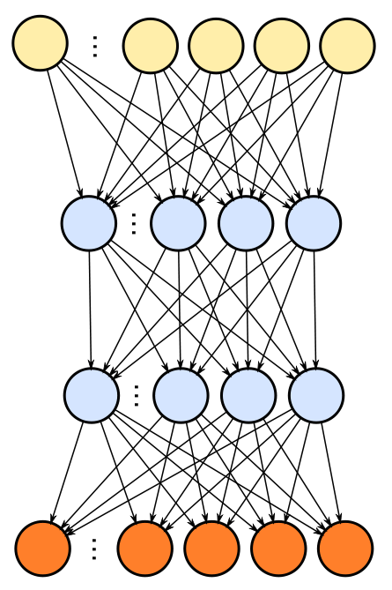
How? - Machine learning
(Deep) Neural Networks
e.g. CSV, DeepCSV
Likelihood classifier
e.g. JP
BDT
e.g. cMVA

Slide 22
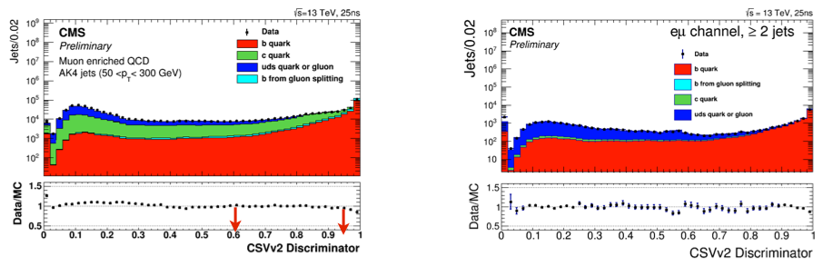
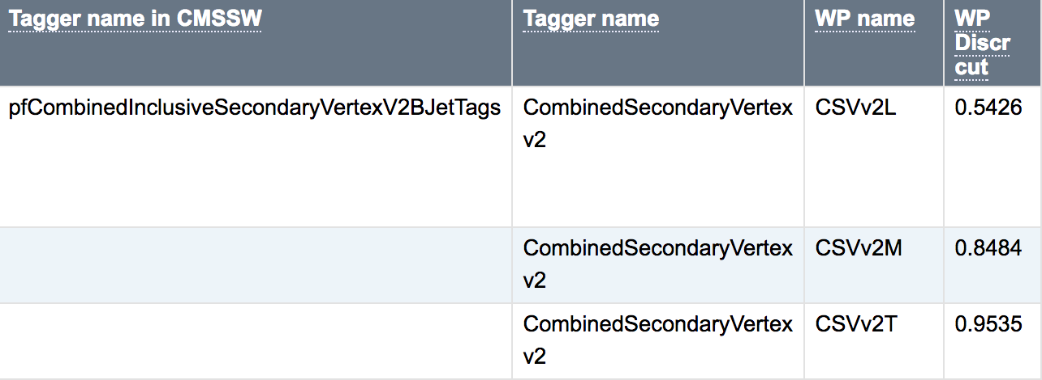
Discriminators
define three operating points based on mistag probabilities (0.1%, 1% and 10%)

Slide 23
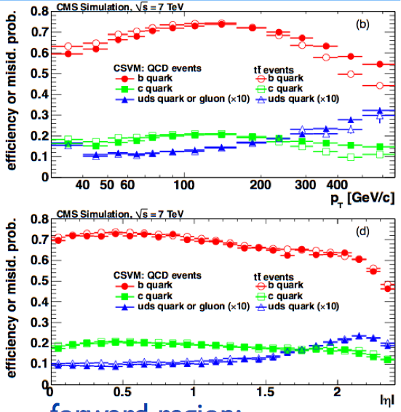
Dependence on kinematics
low-momentum:
more multiple coulomb scattering
smaller Lorentz factor → B hadron decays closer to primary vertex (more difficult to resolve)
high-momentum:
more collimated jets
dense environment difficult for tracking
smaller track curvature
close-by-tracks create overlapping hits in the detector
forward region:
edge effects
detector layers further away from PV

Slide 24
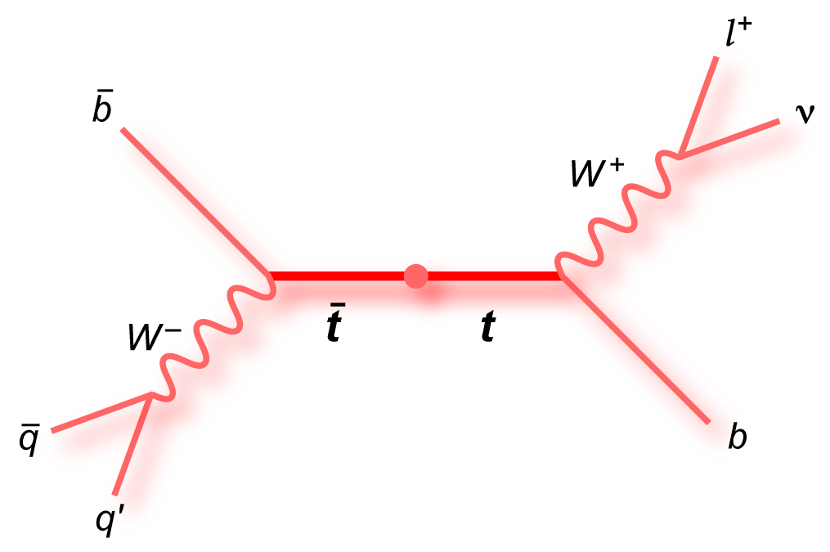
Performance measurements
events with muons in jets:
use characteristic properties of the muon from B decays to measure (fit) the b-content
relative momentum to the jet axis (ptrel) is large because of the B hadron mass
possible to use IP of muon as well (although correlated with b-taggers)
events with top quarks:
select sample with a high fraction of top quark events
the branching fractions of top quarks are well known
the flavour composition of the sample is known as well

Slide 25
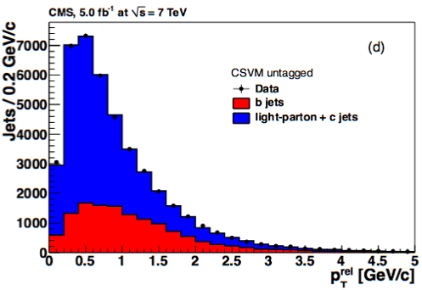
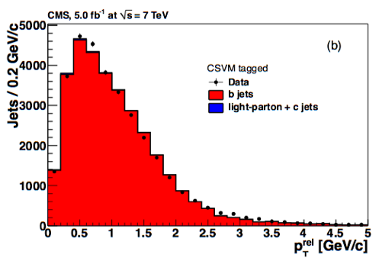
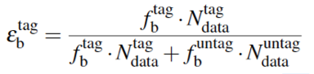
Example, the pT^{rel} method
split sample with jets containing muons into two sets: b-tagged and not b-tagged
fit the blue (light jets) and red (b-jet) shapes to match the data, extract the fractions fb^{tag} and fb^{untag}
Not b-tagged
b-tagged

Slide 26
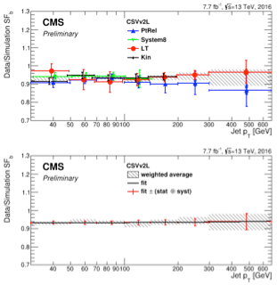

Performance measurements
example for CSV algorithm:
agreement between data and simulation at 5% level
associated uncertainties at 5% level as well
result expressed as “scale factor” to be applied to the simulation
what are reasons the scale factor is not exactly one?
QCD
tt

Slide 27
Data/MC Scale Factors
scale factors derived on jet-by-jet basis
to be applied in simulated events
various methods exist
all methods have advantages and disadvantages
choice for an SF method depends on analysis
jet-by-jet updating
flip b-tag status of individual jets based on drawing random numbers
example: switch 5% of b-tagged b-jets to untagged (for SF=0.95)
event reweighting
calculate event weight based on flavour combination
example: apply weight of 0.95 * 0.95 for events with two b-tagged b-jets (and nothing else!)
… and other options. If in doubt contact the hypernews

Slide 28
Tips and tricks to survive software writing
Program defensively: when making an assumption (e.g. this pointer is valid, this number is > 0) check it! If not learn to raise/throw appropriate exceptions
git is your friend, especially when trying to understand what changed
… and commit often, after every change
learn to read the compiler errors, most of the time are quite descriptive
learn how to use a debugger, pdb is straightforward, gdb much less
command line parsers are a great tool to avoid having lots of files doing just slightly different things
TEST YOUR CODE BEFORE SUBMITTING!
“the difference between a top grader and a bottom grader is not the amount of mistakes per page, but how quickly he/she can find them”
my math professor

Slide 29
Back-up

Slide 30
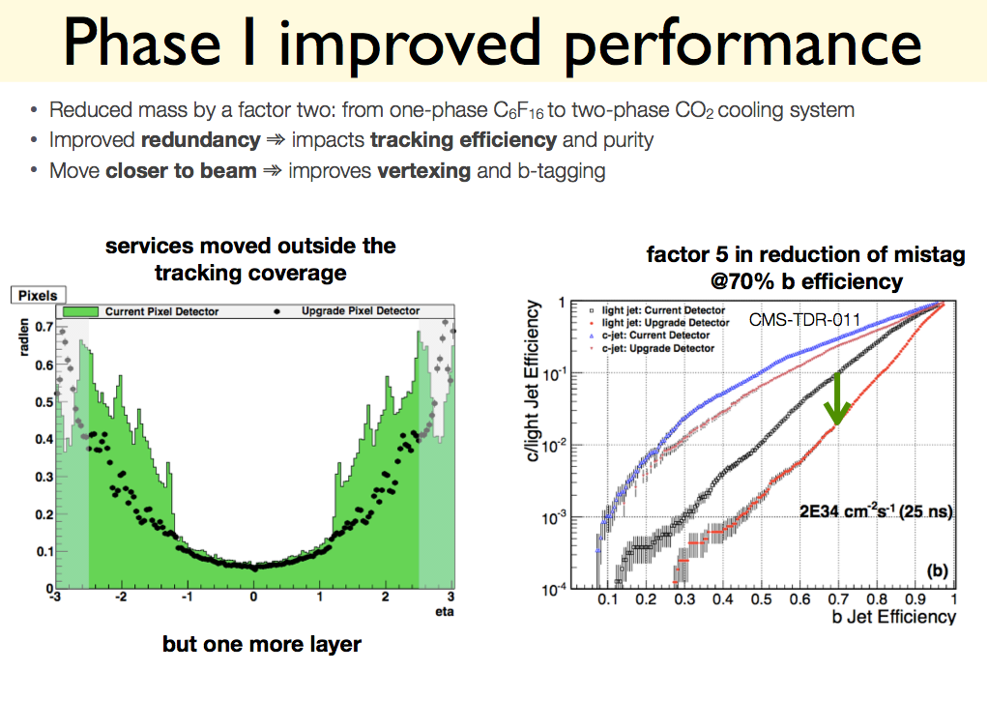

Slide 31
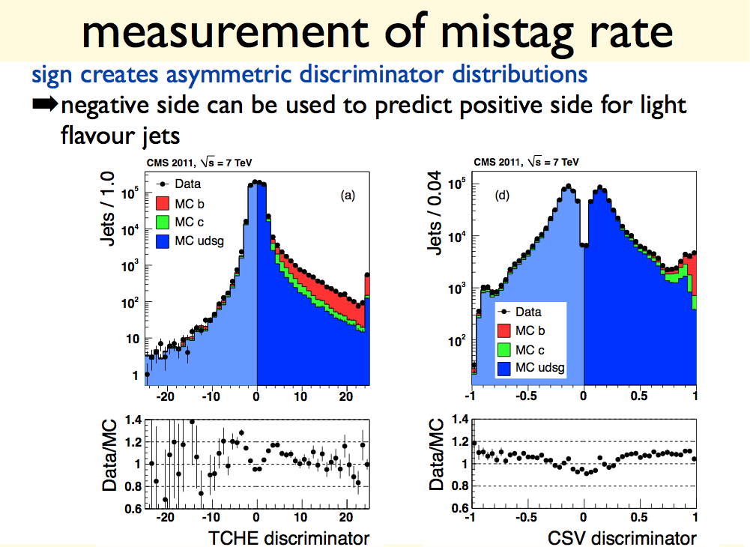

Slide 32
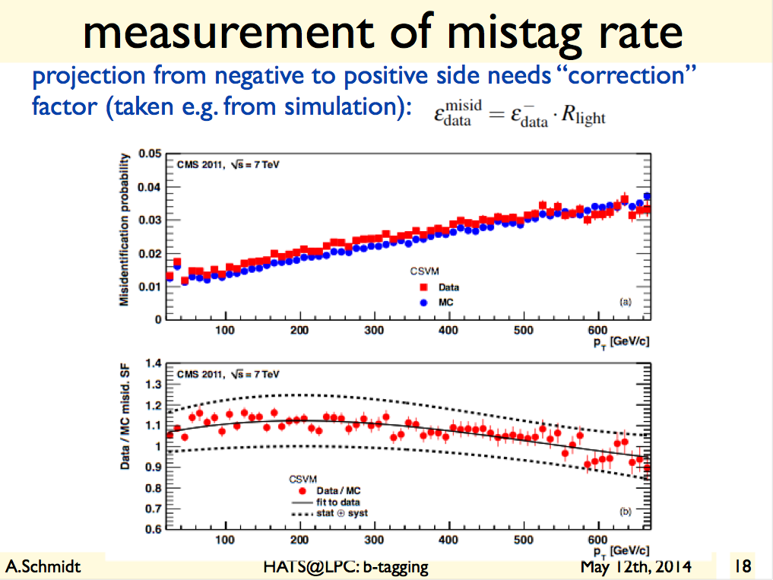

Slide 33
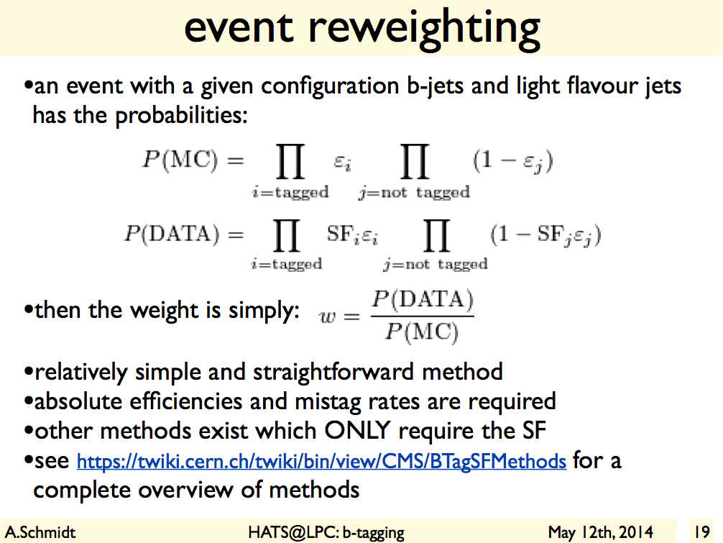

Slide 34
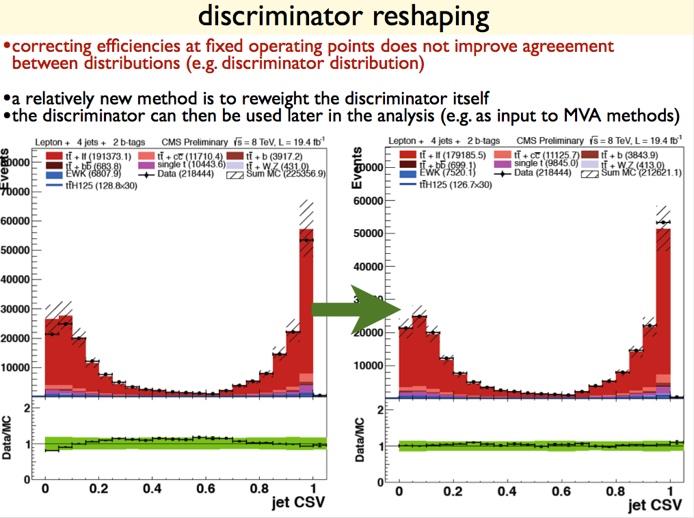

Slide 35
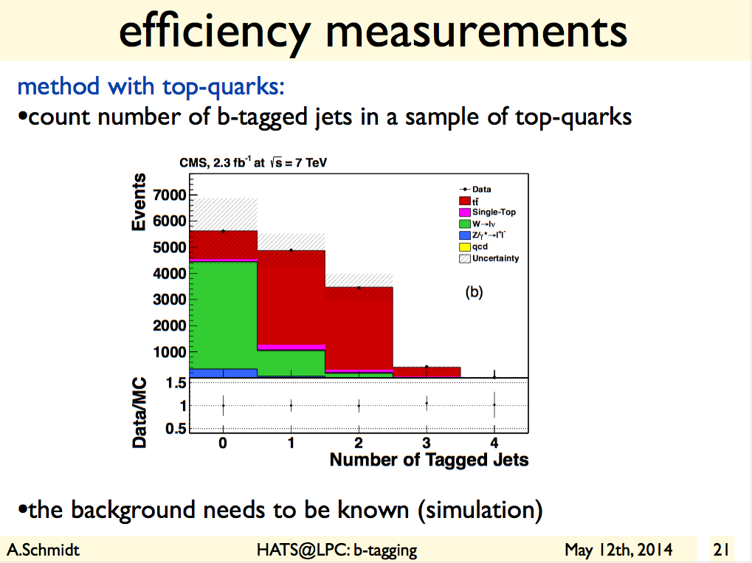

Slide 36
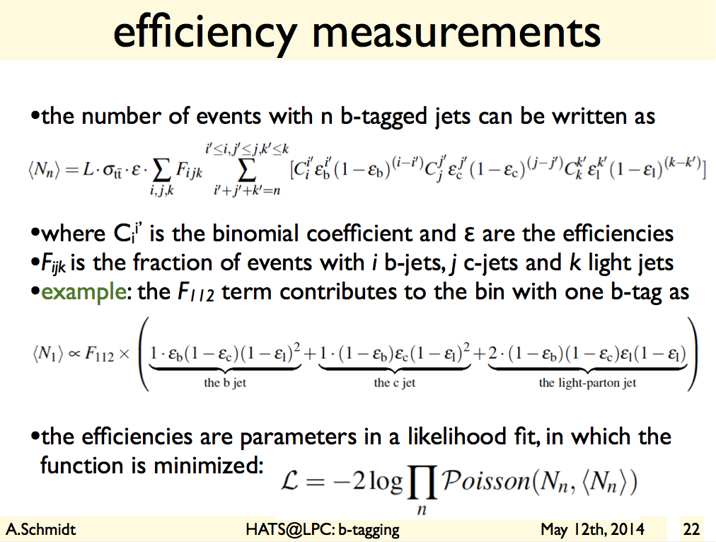

Slide 37
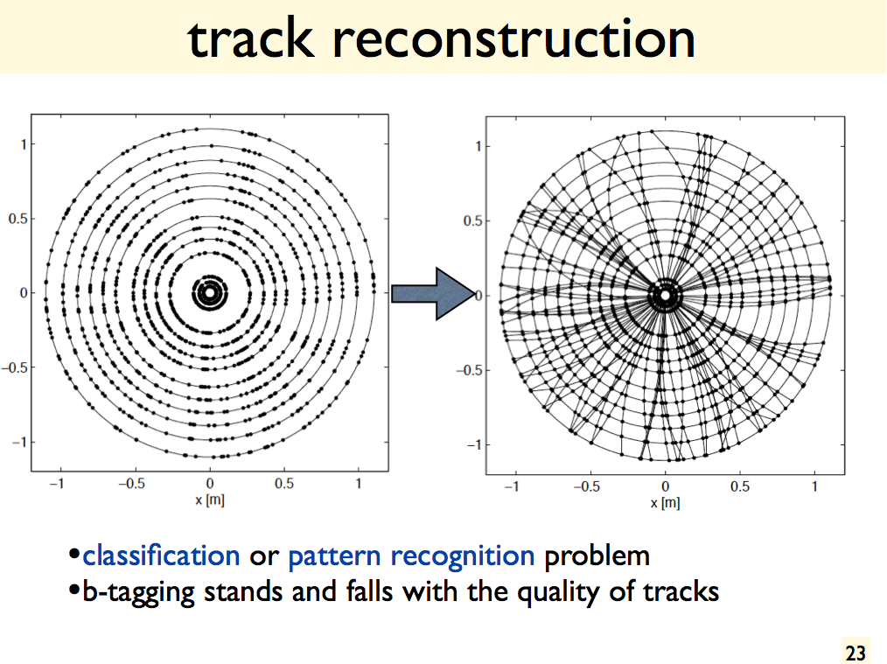

Slide 38
